Slide 1



Department of Computer Science and Engineering
A Novel Benchmark Dataset and CNN-Based Threat Detection Model
Anantha Krishnan B 211420104017 Naveen R 211420104177 Meiyarasan A 211420104327
Mr. M.Mahendran,
M.TECH.,(Ph.D).,
Dr. G.Senthil Kumar, M.C.A.,M.Phil.,M.B.A., M.E., Ph.D

Slide 2
Introduction
The Internet of Things (IoT) has revolutionized our interactions with the environment, offering unprecedented convenience. However, this connectivity introduces security challenges. Intrusion Detection Systems (IDS) play a pivotal role in safeguarding IoT ecosystems. By continuously monitoring network traffic and system behavior, IDS identifies and responds to potential threats. Given the diverse and dynamic nature of IoT networks, specialized IDS are essential for ensuring system integrity. This paper explores the principles, challenges, and advancements of IoT-specific IDS, providing insights into fortifying IoT deployments against cyber threats. By leveraging diverse detection approaches, IDS protect IoT devices and networks from unauthorized access and data breaches. As IoT integration deepens, the role of IDS becomes increasingly critical in ensuring security and resilience.
‹#›

Slide 3
Literature Review
Title : Enhanced network intrusion detection system
Author: Ketan Kotecha, Raghav Verma Prahalad V. Rao Priyanshu Prasad.
Year:2021
An Enhanced Network Intrusion Detection System (NIDS) is an advanced security solution designed to monitor network traffic for suspicious activity or unauthorized access attempts. Unlike traditional IDS, an enhanced NIDS employs sophisticated algorithms, machine learning techniques, and advanced analytics to improve threat detection accuracy and reduce false positives. It can identify both known and unknown threats by analyzing network packets, behavior patterns, and anomalies in real-time. Enhanced NIDS provides organizations with proactive threat detection capabilities, helping them to strengthen their cybersecurity posture and mitigate potential risks to their network infrastructure.

Slide 4
Existing System
Decision trees are a popular machine learning algorithm used for classification and regression tasks. They employ a tree-like structure where each internal node represents a feature, branches represent decision rules, and leaf nodes represent outcomes.
Merits:
Interpretability
1.No Preprocessing
2.Implicit Feature Selection
3.Handles Non-linear Relationships
4.Robust to Outliers
Demerits:
1.Overfitting
2.Instability
3.Bias Towards Dominant Classes
4.Limited Expressiveness
5.High Variance

Slide 5
Existing System
AdaBoost Sequentially trains weak learners, focusing on misclassified instances, and combines their predictions through weighted voting.
Merits:
1. High Accuracy
2. Versatility
3. Implicit Feature Selection
4. Handles Non-linear Relationships:
5. Less Prone to Overfitting
Demerits:
1. Sensitive to Noisy Data
2. Computationally Intensive
3. Bias Towards Easy Examples
4. Interpretability
5. Less Effective on Imbalanced Data

Slide 6
Existing System
Bagging Tree, or Bootstrap Aggregating Tree, is an ensemble learning technique where multiple decision trees are trained independently on different subsets of the training data with replacement.
Merits:
1. Reduced Variance
2. Improved Stability
3. Robustness
4. Parallelizable
Demerits:
1. Increased Complexity
2. Computationally Intensive
3. Limited Interpretability
4. Potential Overfitting
5. Less effective on Imbalanced Data

Slide 7
Existing System
Gradient Boosting is an ensemble learning technique that builds a strong predictive model by sequentially adding weak learners (usually decision trees) to minimize a loss function. Each subsequent weak learner is trained to correct the errors made by the previous ones.
Merits:
1. Enhanced Predictive Accuracy
2. Flexibility
3. Feature Importance
4. Handles Non-linearity
Demerits:
1. Sensitivity to Noisy Data
2. Computationally Intensive
3. Limited Interpretability
4. Potential Overfitting

Slide 8
Proposed System
The proposed CNN-based Intrusion Detection System (IDS) enhances network security by leveraging deep learning techniques to detect and mitigate threats. It starts with collecting network traffic data and preprocessing it to extract relevant features. The CNN architecture is designed for intrusion detection, with experimentation to optimize performance. Data is split into training, validation, and testing sets, with augmentation techniques applied for robustness. Transfer learning from ImageNet can speed up training. After training, the model is evaluated for metrics like accuracy and precision. Upon successful evaluation, the trained CNN model is deployed to monitor real-time network traffic, classifying it as normal or malicious. Integration with existing security infrastructure enables comprehensive threat detection and response mechanisms. Continuous monitoring and periodic retraining ensure adaptability to evolving threats. In summary, the proposed CNN-based IDS provides a robust approach to enhancing network security, enabling organizations to better protect their infrastructure from malicious activities.

Slide 9
Aim and Objective
Objective:
The objective of the proposed Intrusion Detection System (IDS) is to enhance network security using Machine Learning (ML), specifically a Convolutional Neural Network (CNN) architecture. It aims to detect various network intrusions accurately, reduce false positives and negatives, provide real-time monitoring, adapt to evolving threats, and integrate with existing security infrastructure for comprehensive threat detection. Ultimately, the goal is to develop a user-friendly and compliant IDS solution that safeguards networks against malicious activities.
Aim:
The aim of developing an Intrusion Detection System (IDS) using machine learning with a Convolutional Neural Network (CNN) architecture is to create a highly accurate and adaptable system for detecting network intrusions in real life.

Slide 10
Software / Hardware used
1.SOFTWARE REQUIREMENTS
Operating System : Windows
Tool : Matlab 2023
2. HARDWARE REQUIREMENTS:
Processor : Pentium IV/III
Hard disk : minimum 100 GB
RAM : minimum 4 GB

Slide 11
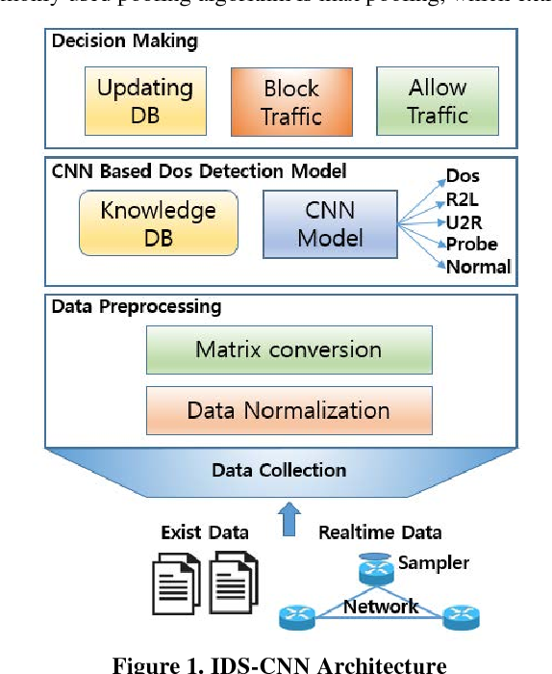
System Architecture

Slide 12
System Architecture
Input Layer:
The input layer of the CNN takes as input the features extracted from the IoT data. In this case, the features are normalized using z-score normalization.
Convolutional Layers:
The CNN consists of multiple convolutional layers, which apply a set of learnable filters to the input data. Each filter extracts features from the input through convolution operations. The number of filters and their sizes are specified in the architecture.
Activation Layers (RELU):
Rectified Linear Unit (RELU) activation functions are applied after each convolutional layer to introduce non-linearity into the network. RELU activations help the model learn complex patterns and relationships in the data.

Slide 13
System Architecture
Batch Normalization Layers:
Batch normalization layers normalize the activations of each layer, improving the ability and convergence of the training process. They reduce the internal covariate shift by scaling and shifting the activations.
Fully Connected Layers:
Following the convolutional layers, the network includes fully connected layers, also known as dense layers. These layers connect every neuron in one layer to every neuron in the next layer, allowing the network to learn high-level representations of the input data.
SoftMax Layer:
The final layer of the CNN is a SoftMax layer, which normalizes the output of the network into a probability distribution over the different classes. It assigns a probability to each class, indicating the likelihood of the input belonging to that class.

Slide 14
System Architecture
Classification Layer:
The classification layer computes the loss and error of the network's predictions during training and updates the model's parameters to minimize these values. It uses categorical cross-entropy loss for multi- class classification tasks like intrusion detection.

Slide 15
Module Description
1.Data Preparation:
Before training the model, the labeled dataset is divided into training, validation, and test sets. The training set is used to teach the model, the validation set helps tune hyperparameters, and the test set evaluates the model’s performance.
2.Algorithm Selection:
The appropriate machine learning algorithm is selected based on the nature of the problem, dataset characteristics, and desired outcomes. Common algorithms for intrusion detection include decision trees, support vector machines (SVM), neural networks, and ensemble methods like Random Forest and Gradient Boosting.
3.Hyperparameter Tuning:
Hyperparameters are parameters that govern the learning process of the model, such as learning rate, regularization strength, and tree depth. Hyperparameter tuning techniques like grid search or random search are employed to find the optimal configuration that maximizes model performance.

Slide 16
Module Description
4.Training Process:
During training, the model iteratively adjusts its parameters to minimize the difference between predicted and actual labels. This is typically done using optimization algorithms like stochastic gradient descent (SGD) or Adam, which update the model parameters based on gradients computed from the training data.
5.Evaluation and Validation:
The model’s performance is evaluated using the validation set, which provides an unbiased estimate of its generalization ability. Metrics such as accuracy, precision, recall, F1 score, and area under the ROC curve (AUC-ROC) are computed to assess the model’s effectiveness in detecting intrusions while minimizing false alarms.
6.Iterative Refinement:
The training process may involve multiple iterations of tweaking hyperparameters, experimenting with different algorithms, or incorporating new features to improve model performance.

Slide 17
Module Description
This iterative refinement is essential for building robust and accurate intrusion detection systems.
7.Model Deployment:
Once the model has been trained and validated, it is deployed into production environments to monitor and analyze real-time data streams from IoT devices.

Slide 18
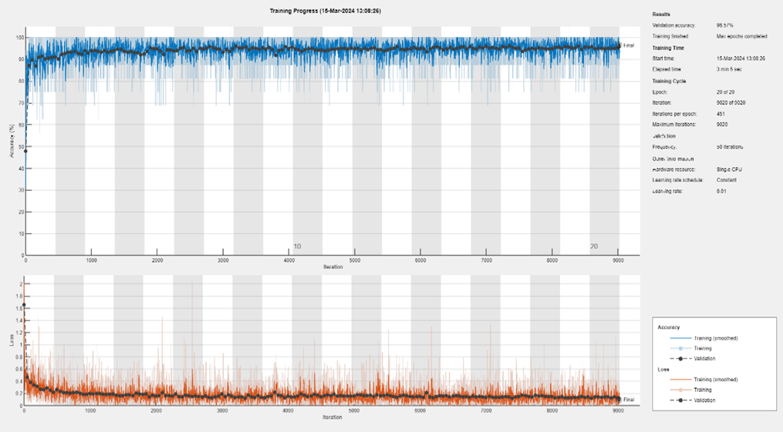
Result
Output of CNN Model

Slide 19
Conclusion
Key Findings:
The developed CNN-based Intrusion Detection System demonstrated commendable performance in accurately discerning normal and malicious activities within IoT networks.
Effectiveness of the Proposed Model:
The proposed CNN architecture, with integrated Batch Normalization, showcased improved stability, convergence, and overall efficiency during training, contributing to enhanced intrusion detection capabilities.
Contributions to IoT Security:
The research contributes valuable insights into the application of deep learning, specifically CNNs, for bolstering the security of IoT ecosystems. The integration of Batch Normalization addresses challenges and limitations encountered in traditional methods.

Slide 20
Future Scope
The future of CNN-based IoT intrusion detection systems (IDS) is promising, offering solutions to the evolving cybersecurity challenges posed by the expanding IoT landscape. As IoT networks grow in size and complexity, traditional security measures become insufficient against sophisticated threats. CNN-based IDS leverage deep learning to analyze diverse IoT data streams in real-time, offering a compelling defense mechanism. Future development will focus on refining CNN architectures, feature extraction methods, and training strategies to enhance detection accuracy and efficiency. Advancements in edge computing and federated learning will enable lightweight CNN models to be deployed directly on IoT devices, enabling localized intrusion detection without centralized processing. Integration of explainable AI techniques will enhance interpretability, fostering trust and informed decision-making. Additionally, interdisciplinary approaches combining CNN-based IDS with emerging technologies like blockchain and edge computing will contribute to creating holistic and resilient IoT security frameworks.

Slide 21
Reference Paper/ URL
Chaabouni, Nadia, Mohamed Mosbah, Akka Zemmari, Cyrille Sauvignac, and Parvez Faruki. "Network intrusion detection for IoT security based on learning techniques." IEEE Communications Surveys & Tutorials 21, no. 3 (2019): 2671-2701.
Zarpelão, Bruno Bogaz, Rodrigo Sanches Miani, Cláudio Toshio Kawakani, and Sean Carlisto de Alvarenga. "A survey of intrusion detection in Internet of Things." Journal of Network and Computer Applications 84 (2017): 25-37.
Ge, Mengmeng, Xiping Fu, Naeem Syed, Zubair Baig, Gideon Teo, and Antonio Robles-Kelly. "Deep learning-based intrusion detection for IoT networks." In 2019 IEEE 24th pacific rim international symposium on dependable computing (PRDC), pp. 256-25609. IEEE, 2019.
Ge, Mengmeng, Xiping Fu, Naeem Syed, Zubair Baig, Gideon Teo, and Antonio Robles-Kelly. "Deep learning-based intrusion detection for IoT networks." In 2019 IEEE 24th pacific rim international symposium on dependable computing (PRDC), pp. 256-25609. IEEE, 2019
.

